Slide 1
SISRs
An effective ruin & recreate heuristic based on slack induction
Jan Christiaens
Greet Vanden Berghe greet.vandenberghe@cs.kuleuven.be

Slide 2
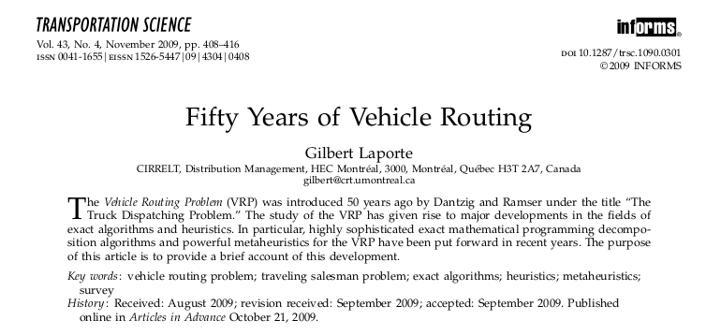
Notes:
What remains to be done? Talk is not solely on VRP but primarily about the development of local search heuristic components

Slide 3
Heuristics
Notes:
A little history

Slide 4
Some VRP heuristics
TSP heuristics | Reference
2-opt | Croes 1958
3-opt | Lin 1965
k-opt | Lin and Kernighan 1973
or-opt | Or 1976
VRP heuristics | Reference
2-opt as inter-route operator
or-opt as inter-route operator
Single, double, pair+single and double pair procedures | Waters 1978
Chain-exchange | Fahrion and Wrede 1990

Slide 5
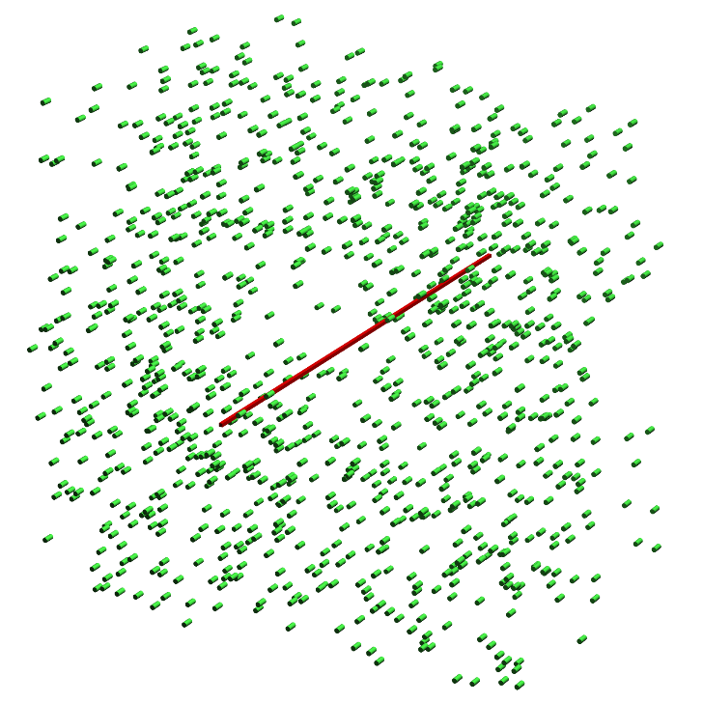
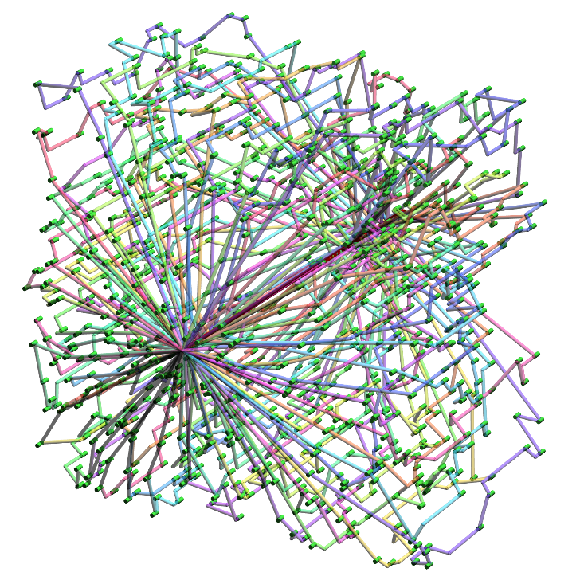
VRPTW heuristics
VRPTW heuristics | Reference
Exchange, cross and relocate | Savelsbergh 1988
2-opt* | Potvin and Rousseau 1995
CROSS-exchange | Taillard et al. 1997
Notes:
3D presentation - 1000 randomly spread customers, short TW, 2-opt*: preserves node order

Slide 6
Ruin & recreate heuristics
 | Reference | Ruin | Recreate
LNS | Shaw 1998 | related removal | Branch & Bound
R&R | Schrimpf et al. 2000 | random, radial or string removal | greedy insertion
ALNS | Pisinger and Røpke 2007 | random, worst, related, cluster, time-oriented or historical removal | greedy or regret insertion with(out) noise function
SISRs | THIS TALK | adjacent string removal | greedy insertion with blinks

Slide 7
Data
Notes:
Data and generalisations – Accessibility – Academic instances - A little history

Slide 8
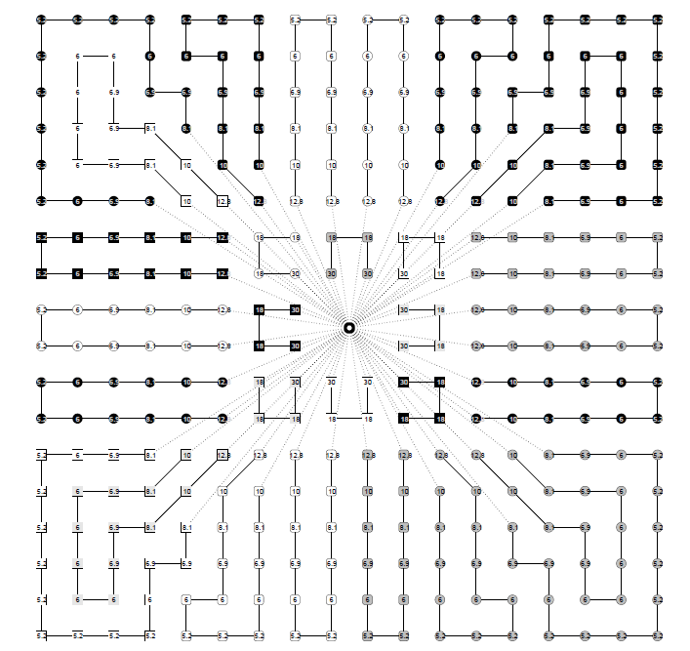
Notes:
Data and generalisations

Slide 9
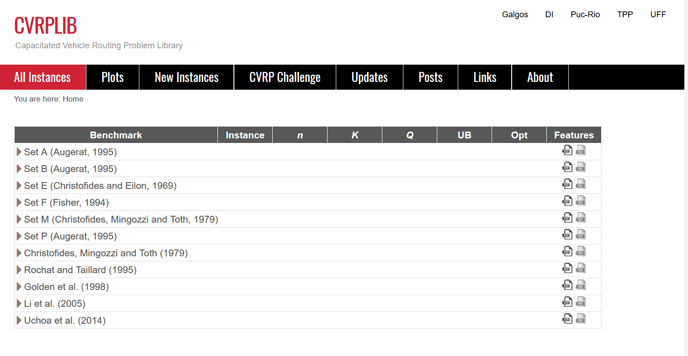
Notes:
New instance sets, realistic characteristics.

Slide 10
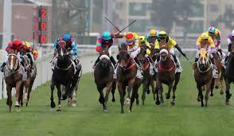
Notes:
People trying to get their names on the leaderboard.

Slide 11
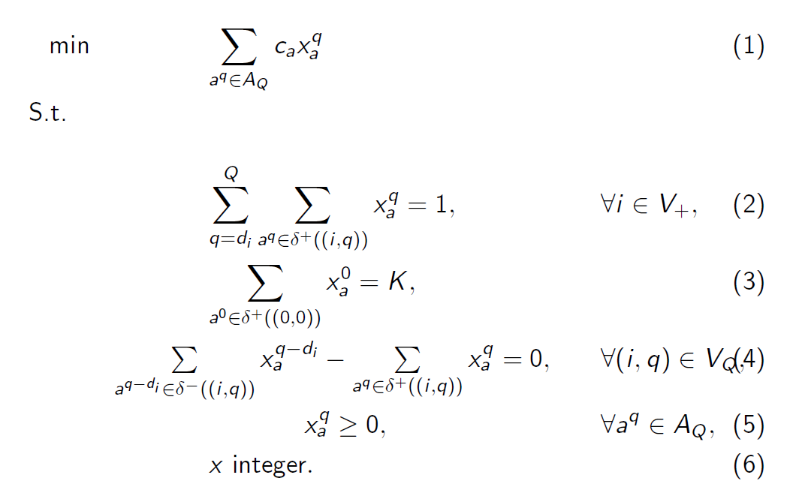
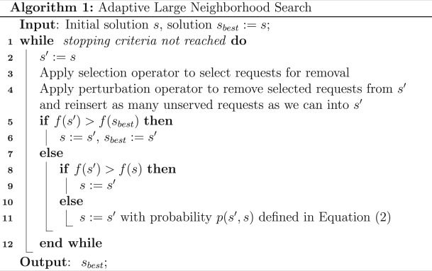
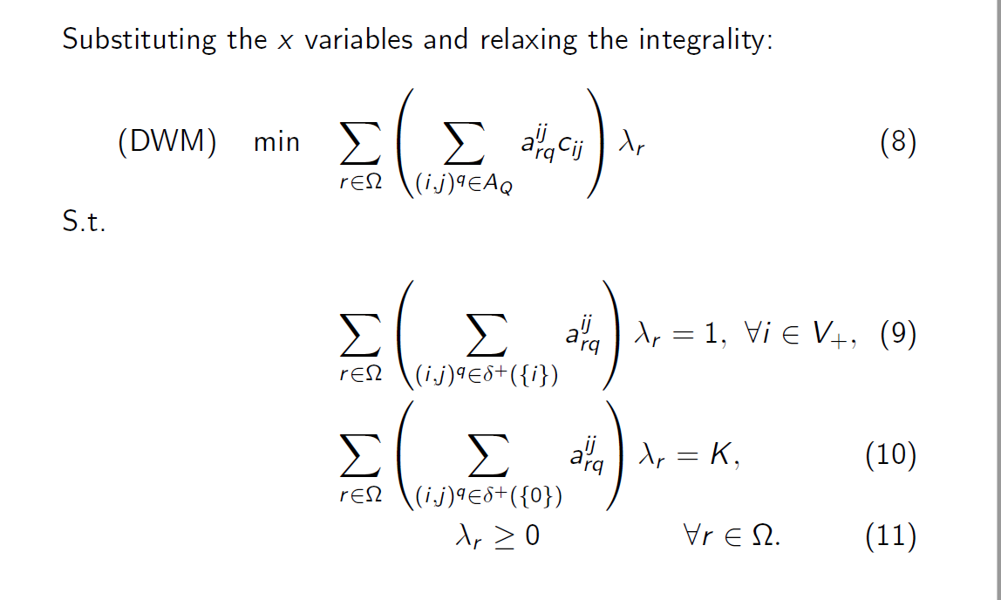
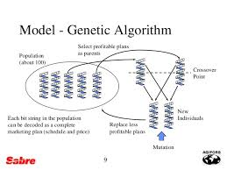
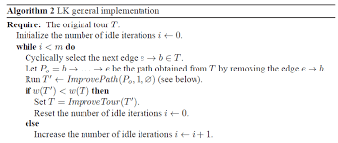
Notes:
dedicated heuristics vs general heuristics, complicated combinations, large numbers of local search heuristics embedded in a metaheuristic framework

Slide 12
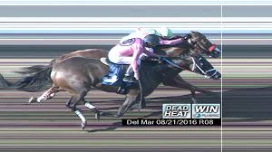
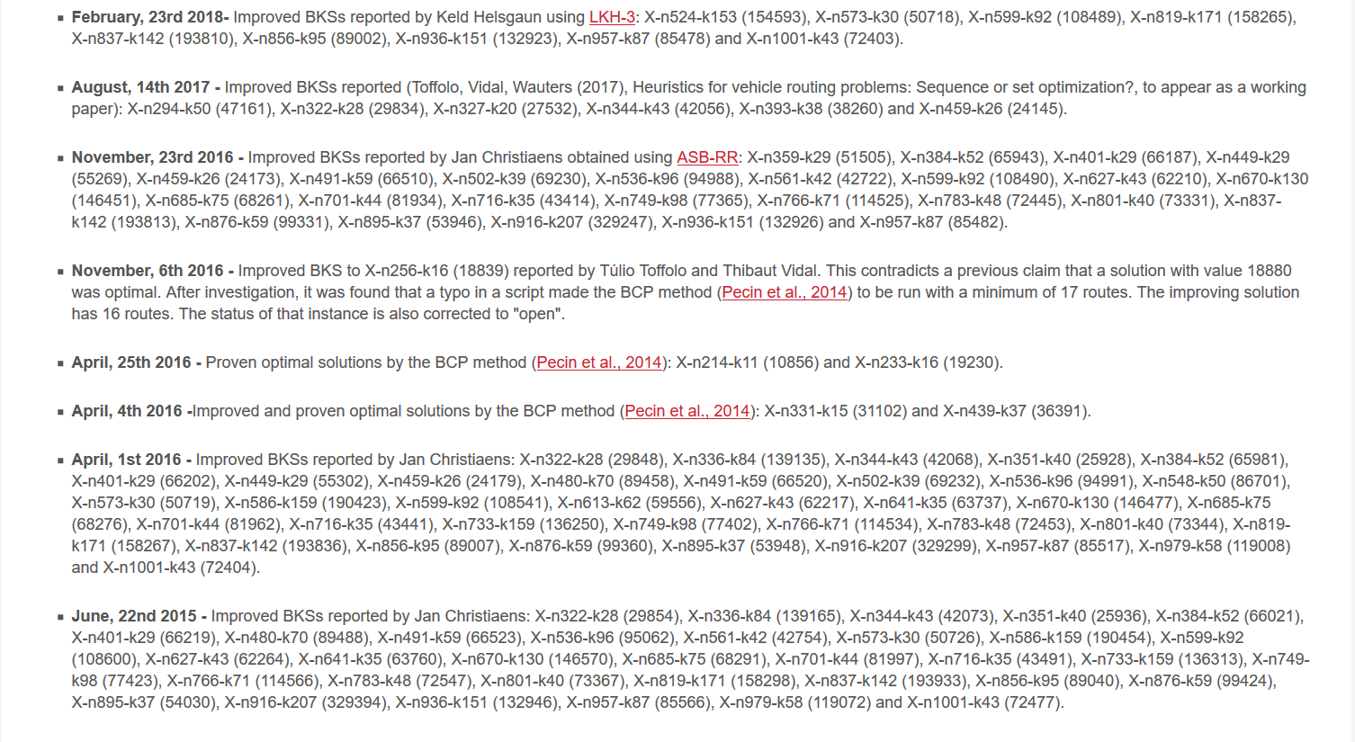

Slide 13
SISRs
Ruin
Recreate
Fleet minimisation

Slide 14
1. SISRs ruin
Remove customers – Adjacent string removal
capacity slack - vehicles gain free capacity
spatial slack - vehicles are detached from regions
Notes:
A little history

Slide 15
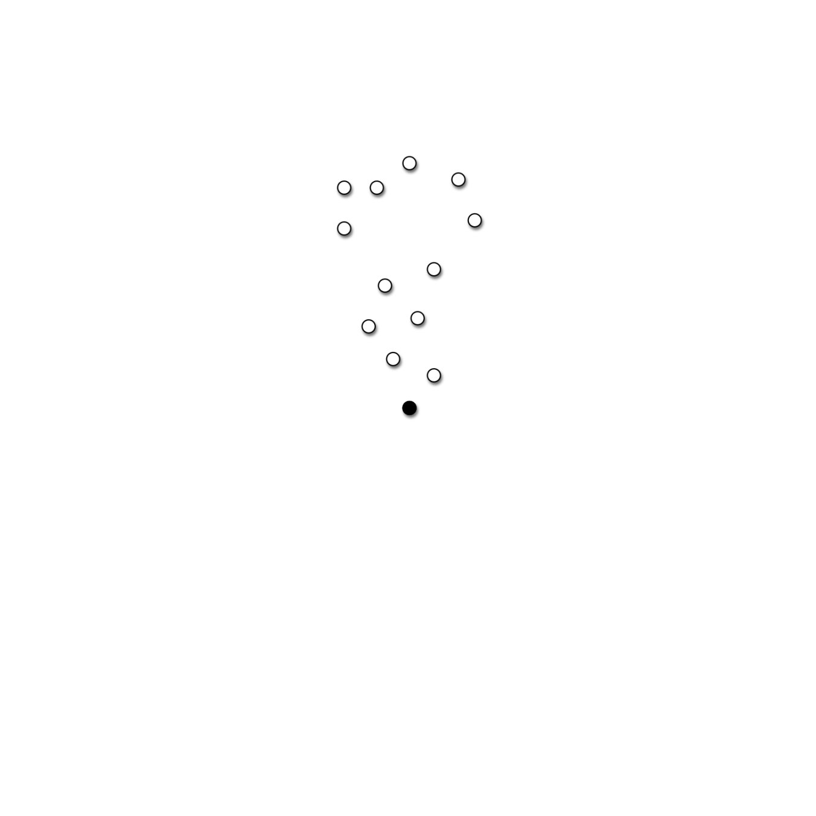
Spatial slack

Slide 16

Spatial slack – Maximum distance

Slide 17

Spatial slack – Maximum distance

Slide 18

Spatial slack – Total distance

Slide 19

Spatial slack – Total distance

Slide 20
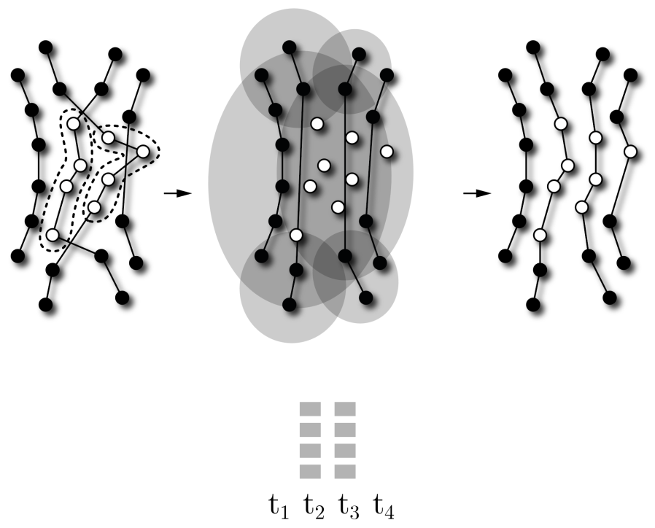
SISRs ruin – Ajacent string removal

Slide 21
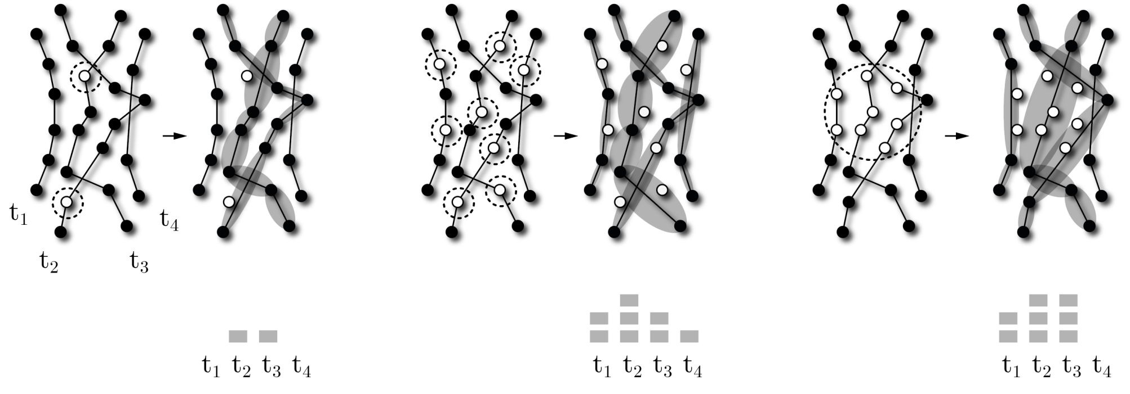
Ruin methods - Alternatives
Small number
Random
Radial

Slide 22
Ruin methods - Alternatives
Small number
Random
Radial

Slide 23
Ruin methods - Alternatives
Small number
Random
Radial
Notes:
INZICHT in problem: RUIN & RECREATE – ALNS = bs

Slide 24
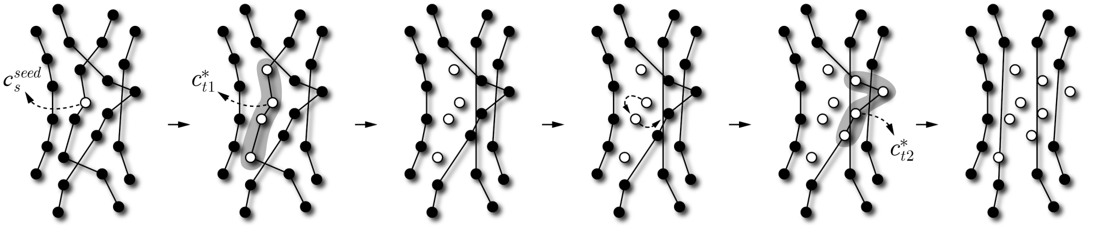
SISRs ruin – Ajacent string removal

Slide 25
SISRs ruin – Ajacent string removal

Slide 26
SISRs ruin – Ajacent string removal

Slide 27
SISRs ruin – Ajacent string removal

Slide 28
SISRs ruin – Ajacent string removal

Slide 29
SISRs ruin – Ajacent string removal

Slide 30
2. SISRs recreate
insert customers - greedy insertion with blinks
options enabled by slack - strongly dependent on ruin
Notes:
A little history

Slide 31
SISRs recreate

Slide 32
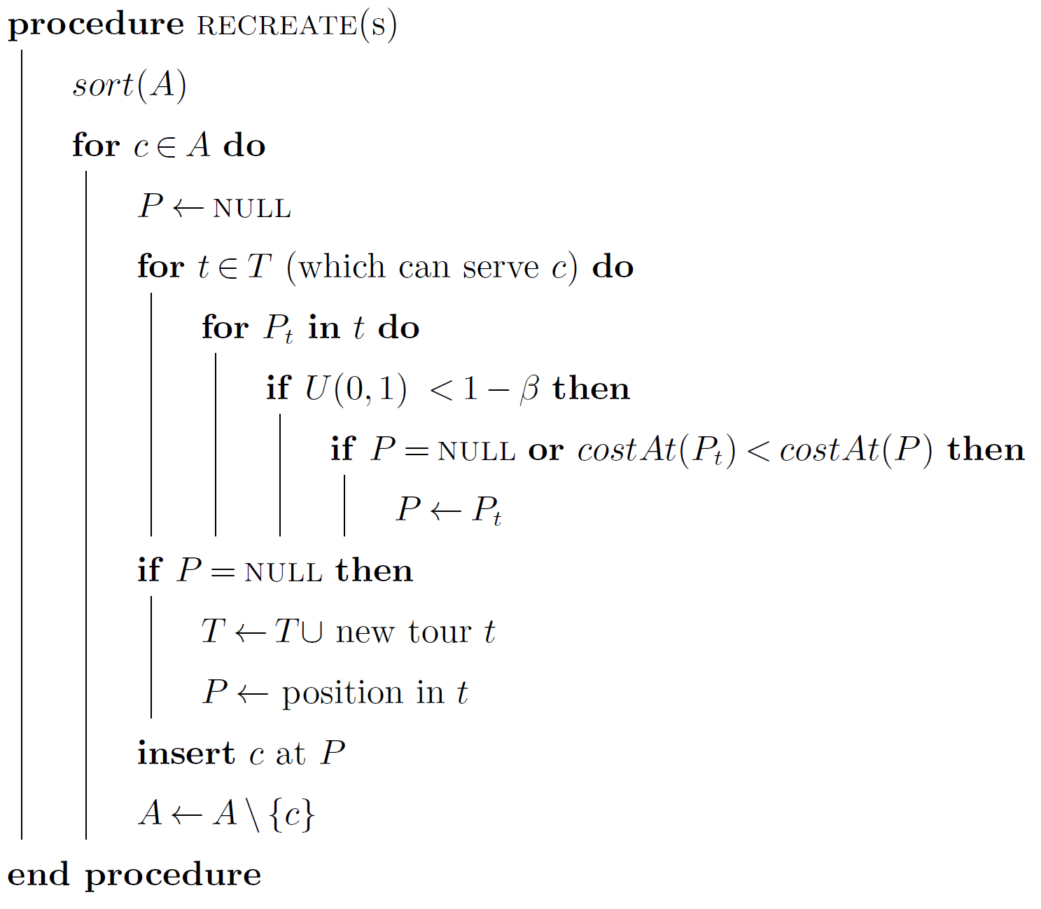
SISRs recreate – Greedy insertion with blinks
Greedy insertion:
always at best position
very greedy ☹
Greedy insertion with blinks:
Heuristic-Biased Stochastic Sampling

Slide 33
SISRs recreate – Greedy insertion with blinks
Greedy insertion:
always at best position
very greedy ☹
Greedy insertion with blinks:
mostly at best position
less greedy ☺
Heuristic-Biased Stochastic Sampling

Slide 34
SISRs Recreate – Greedy insertion with blinks
Greedy insertion:
always at best position
very greedy ☹
Greedy insertion with blinks:
mostly at best position
less greedy ☺
Heuristic-Biased Stochastic Sampling
HBSS (Bresina 1996)
rank all options (best to worst)
exponentially decreasing probability

Slide 35
SISRs recreate – Greedy insertion with blinks
Greedy insertion:
always at best position
very greedy ☹
Greedy insertion with blinks:
mostly at best position
less greedy ☺
rank-based selection probabilities
without ranking all options!! ☺
Heuristic-Biased Stochastic Sampling
HBSS (Bresina 1996)
rank all options (best to worst)
exponentially decreasing probability

Slide 36
3. SISRs fleet minimisation
Fleet minimisation - absences-based acceptance criterion
Notes:
A little history

Slide 37
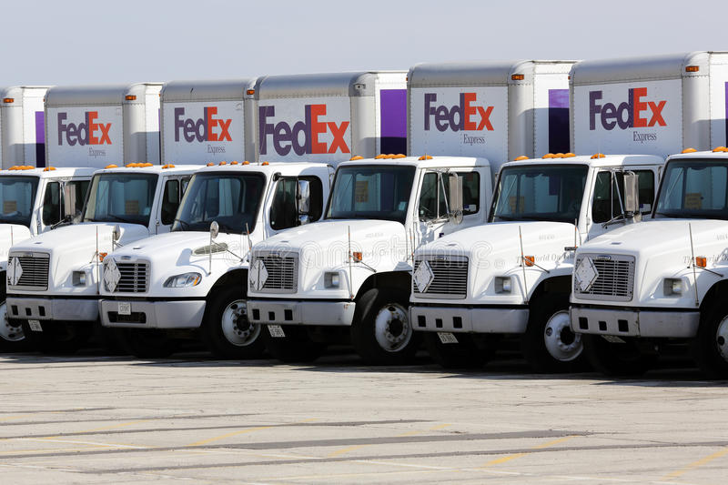

Slide 38
SISRs fleet minimisation
  VRPTW, PDPTW …
Not strictly related to distance → two-stage approach
    Fleet minimisation
    Distance minimisation
Nagata, Bräysy, and Dullaert (2010) VRPTW
  Nagata and Kobayashi (2010) PDPTW
    Remove vehicle
    “Squeeze” until all customers are served
    Repeat

Slide 39

Fleet minimisation – 1st attempt
Consider partial solutions
Let A = set of absent customers
Apply SISRs
Accept s* if
Repeat
$$\left|A\right|≥\left|A^{∗}\right|$$

Slide 40
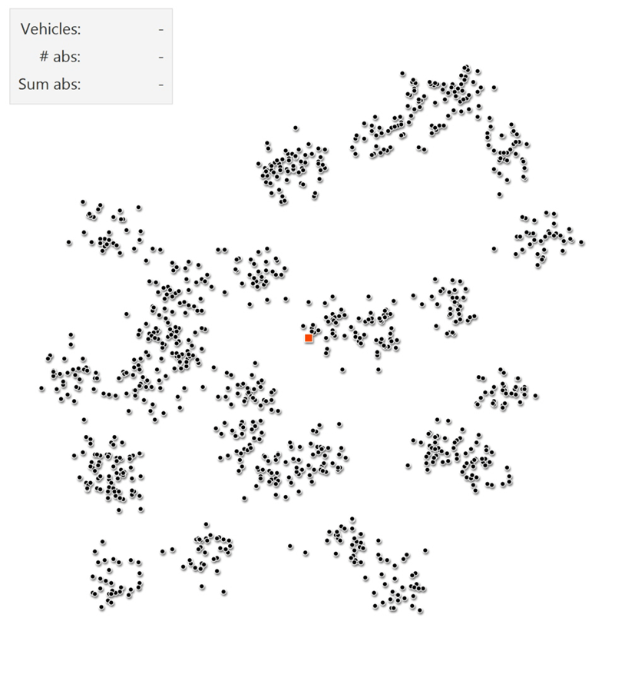

Slide 41
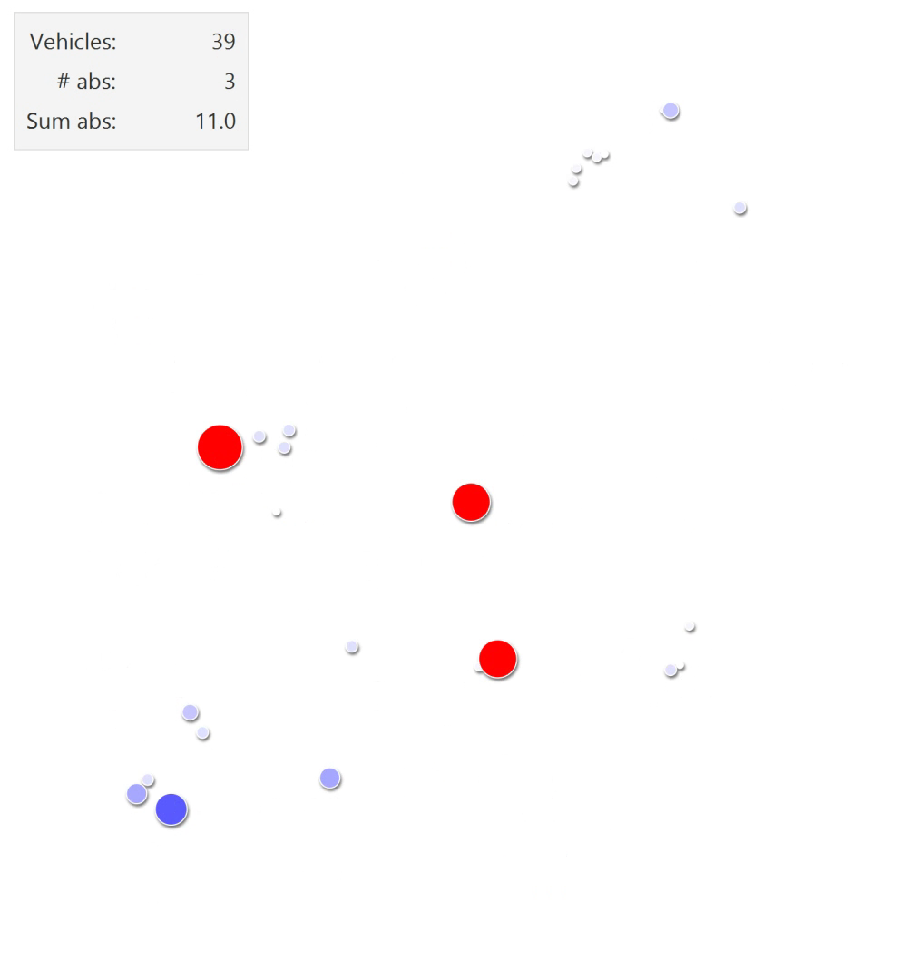

Slide 42
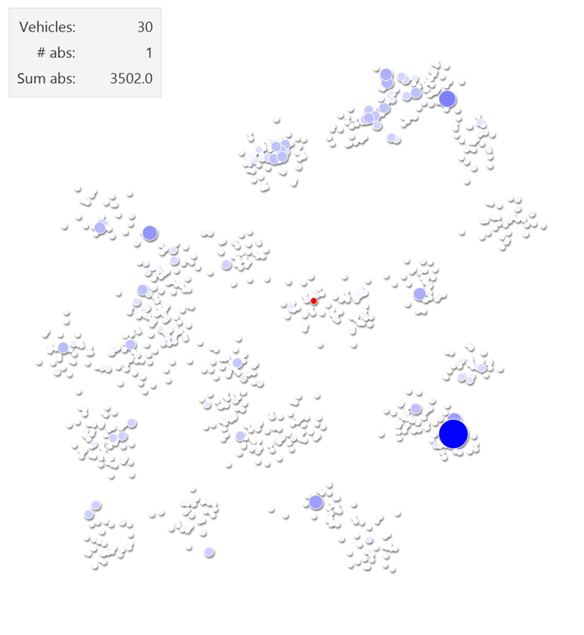

Slide 43
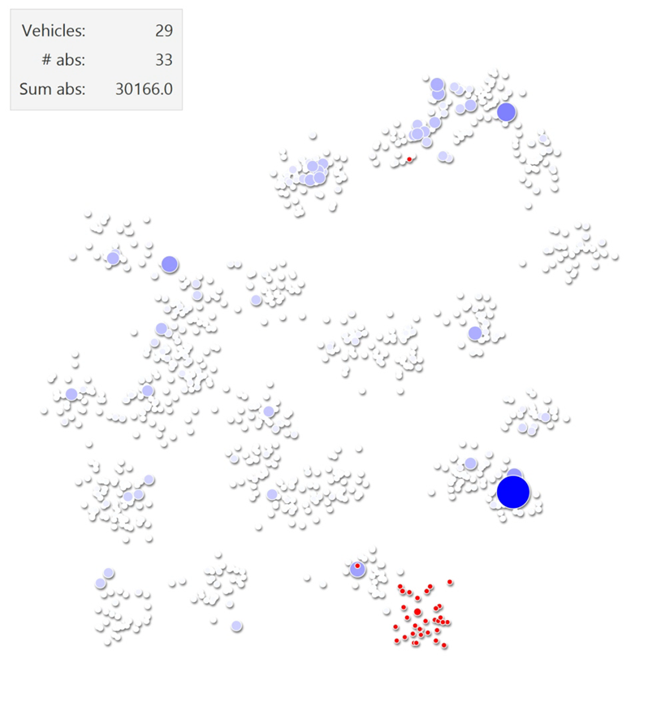

Slide 44

Notes:
Speelt tot moeilijke klanten zichtbaar worden

Slide 45
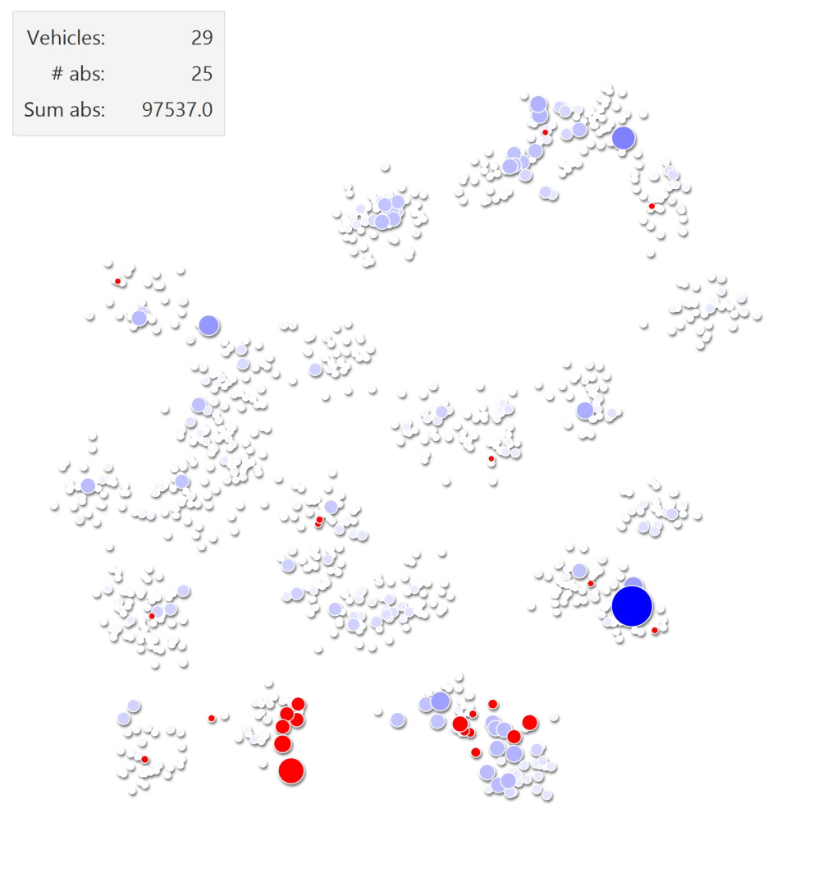
😐
Notes:
Speelt tot moeilijke klanten extreem worden

Slide 46
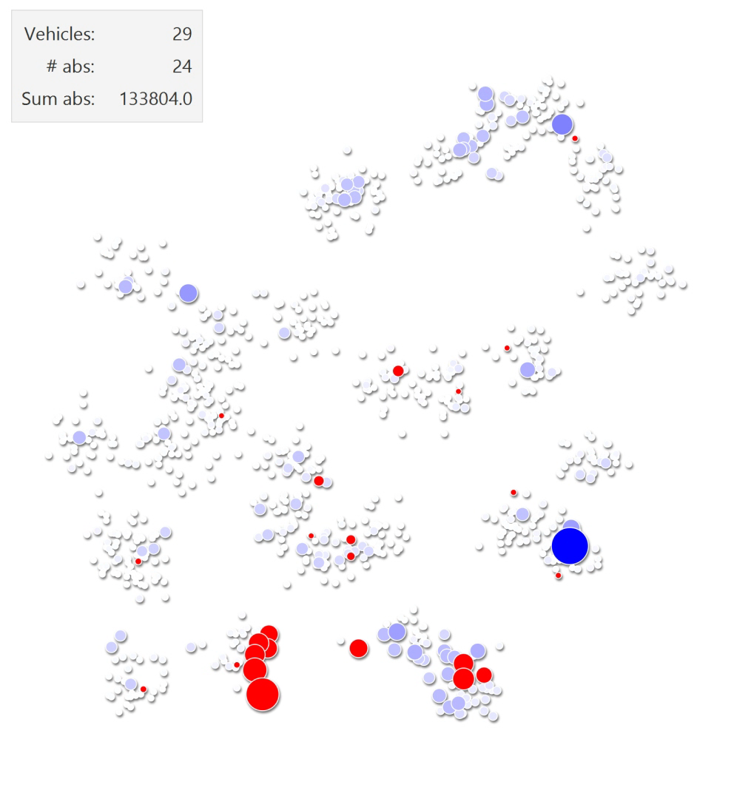
☹
Notes:
Speelt tot moeilijke klanten verdwijnen

Slide 47
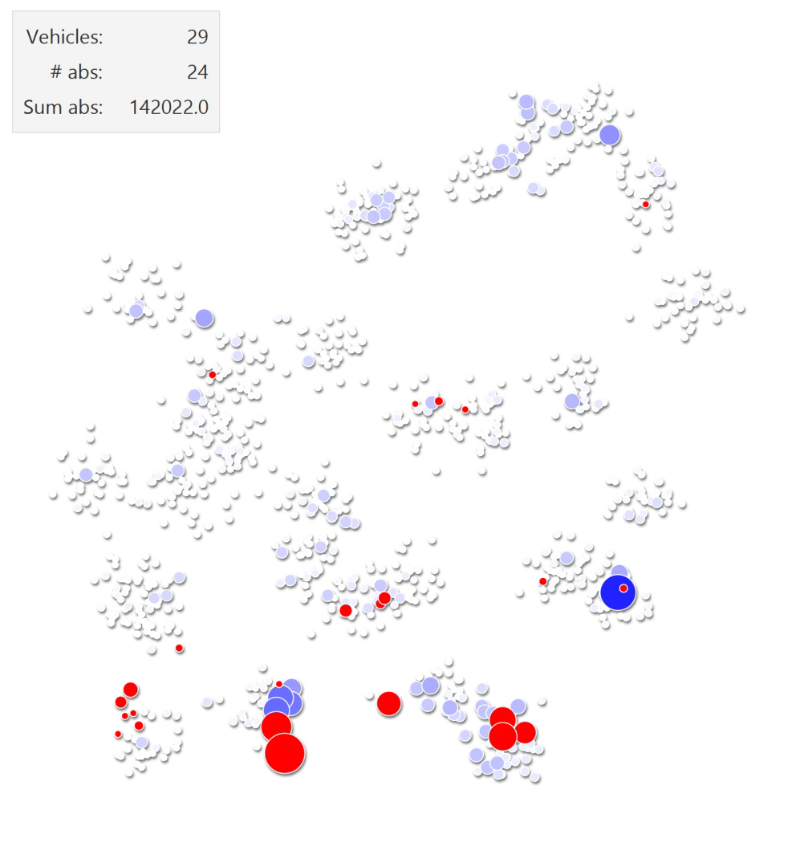
☺
Notes:
Speelt tot moeilijke klanten verdwijnen

Slide 48
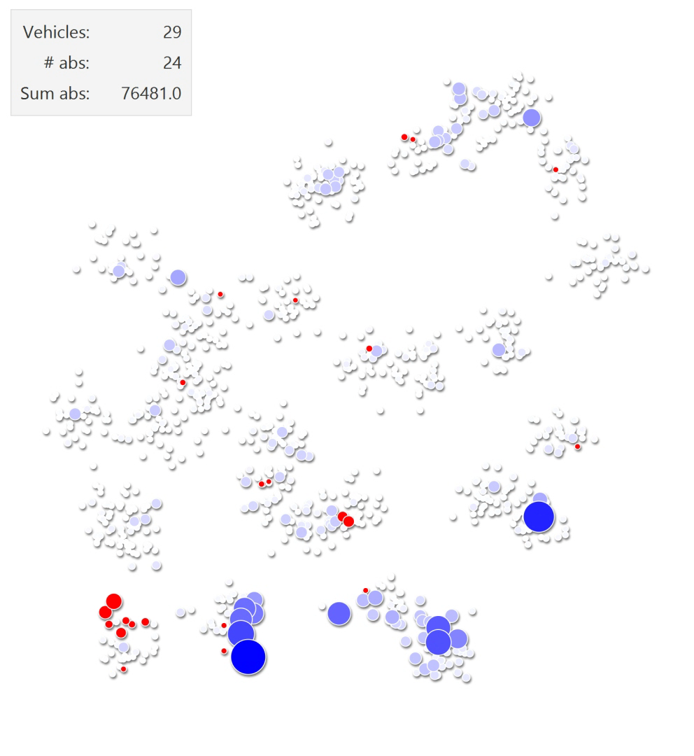
Notes:
Speelt tot moeilijke klanten verdwijnen

Slide 49
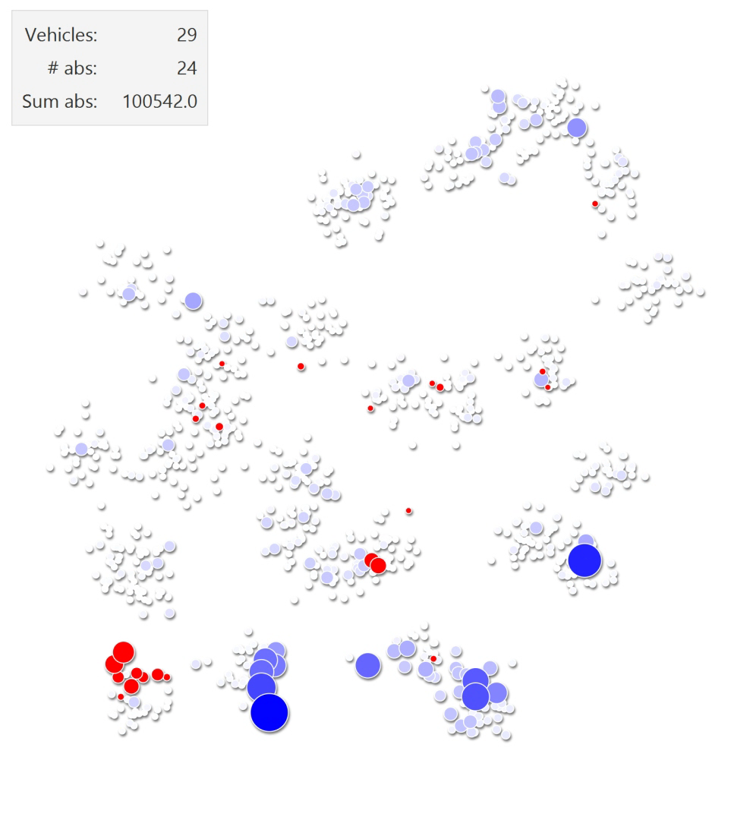
😐
Notes:
Speelt tot moeilijke klanten verdwijnen

Slide 50
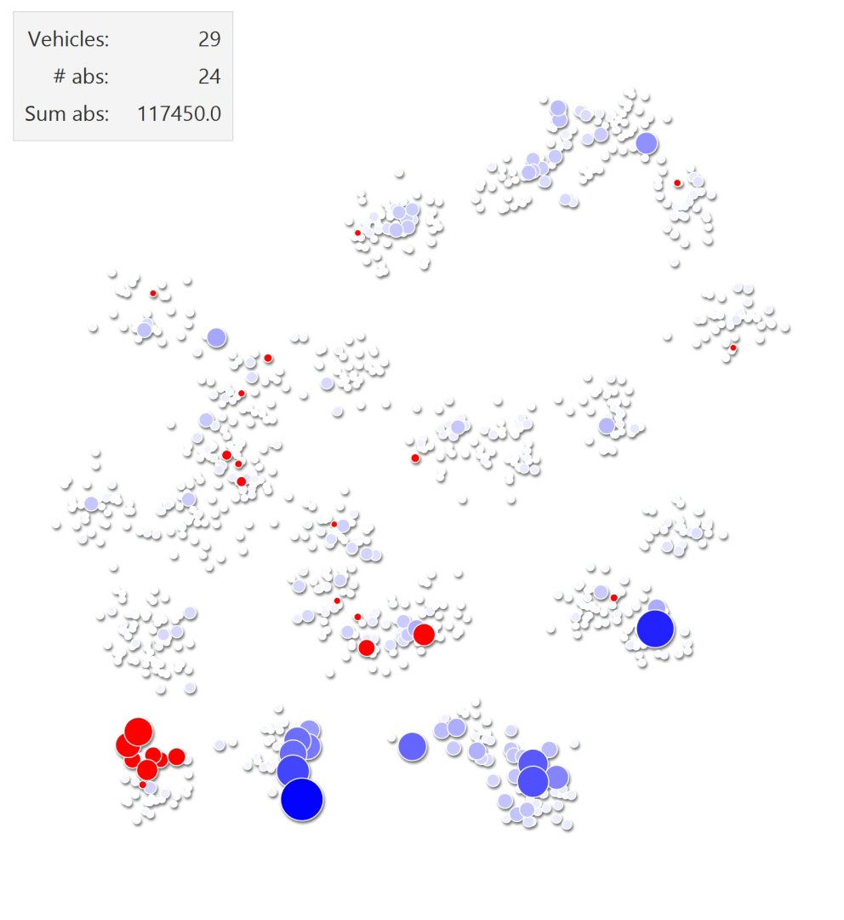
☹
Notes:
Speelt tot moeilijke klanten verdwijnen

Slide 51
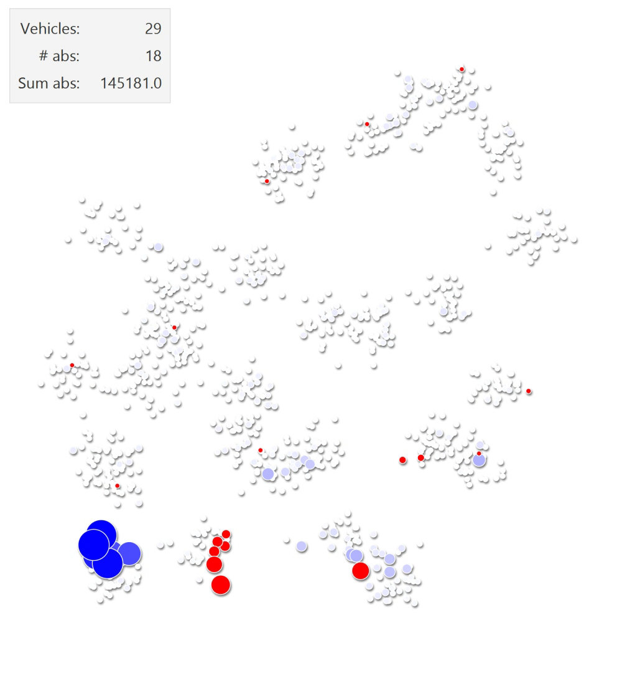
☺
Notes:
Speelt tot moeilijke klanten verdwijnen

Slide 52
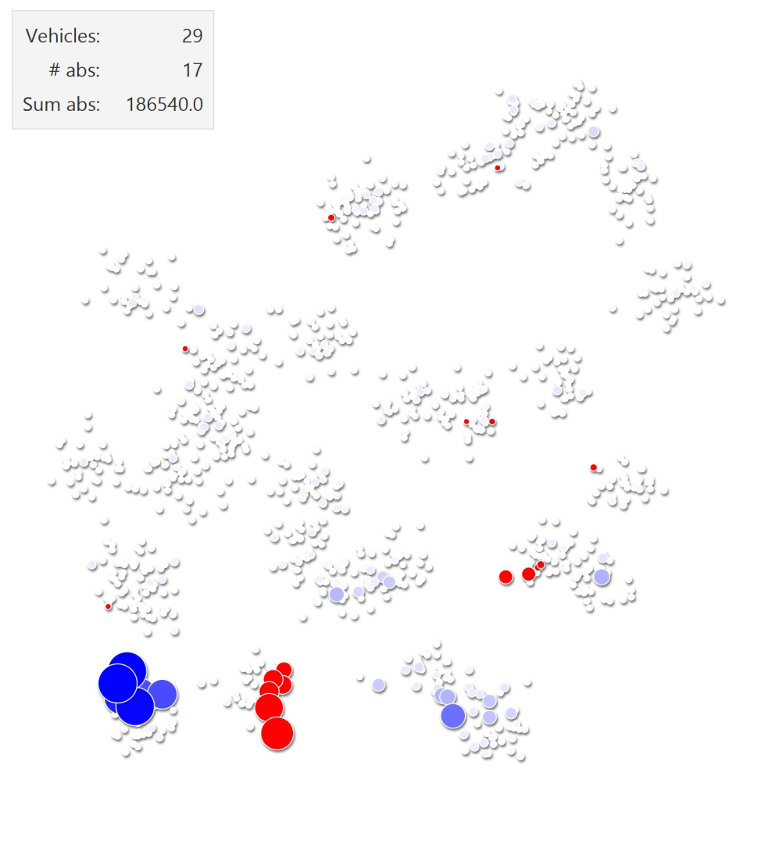
☹
☹
☹
Notes:
Speelt tot moeilijke klanten verdwijnen

Slide 53
Absences-based acceptance criterion
Accept s* if

Slide 54

Absences-based acceptance criterion
Accept s* if
$$\left|A\right|>\left|A^{∗}\right|$$

Slide 55
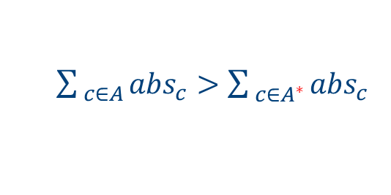
Absences-based acceptance criterion
Accept s* if
$$\left|A\right|>\left|A^{∗}\right|$$
or if
$\sum_{ c∈A}{{abs}_{c}}>\sum_{ c∈A^{∗}}{{abs}_{c}}$

Slide 57
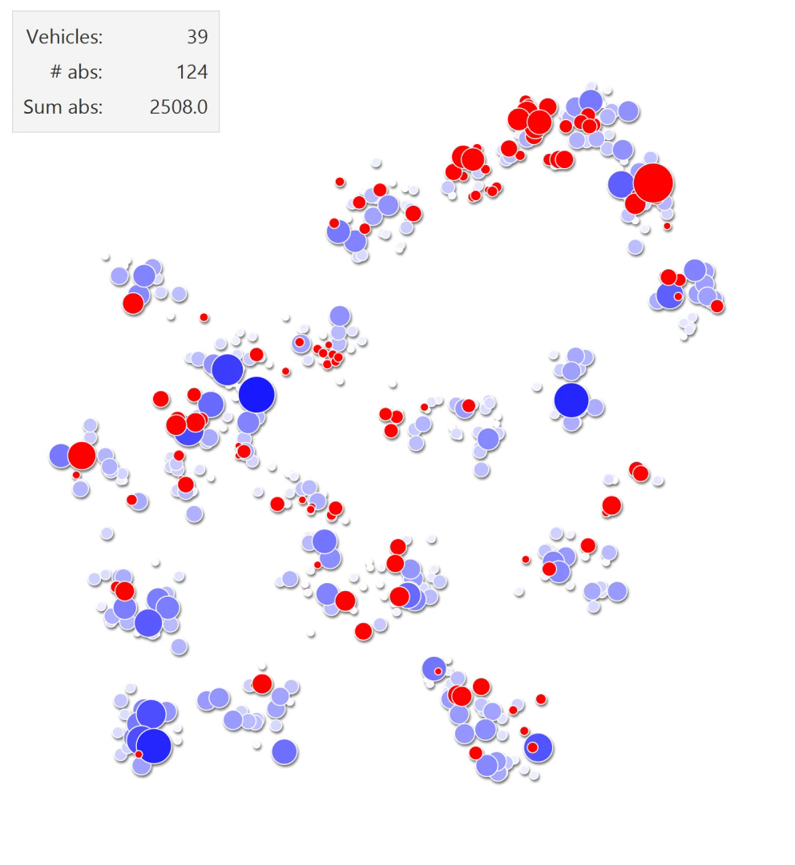
Notes:
Speelt tot moeilijke klanten verdwijnen

Slide 58
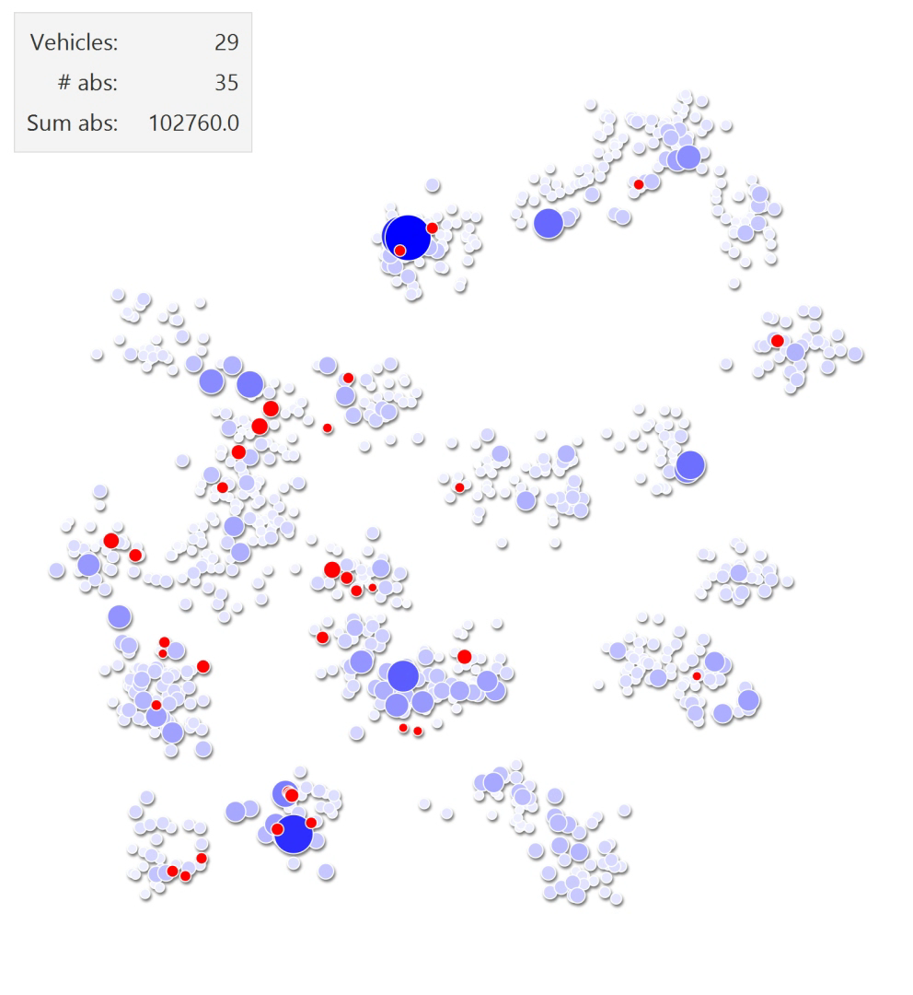
Skip to
29 vehicles
Notes:
Speelt tot moeilijke klanten verdwijnen

Slide 59
Notes:
Speelt tot moeilijke klanten verdwijnen

Slide 60
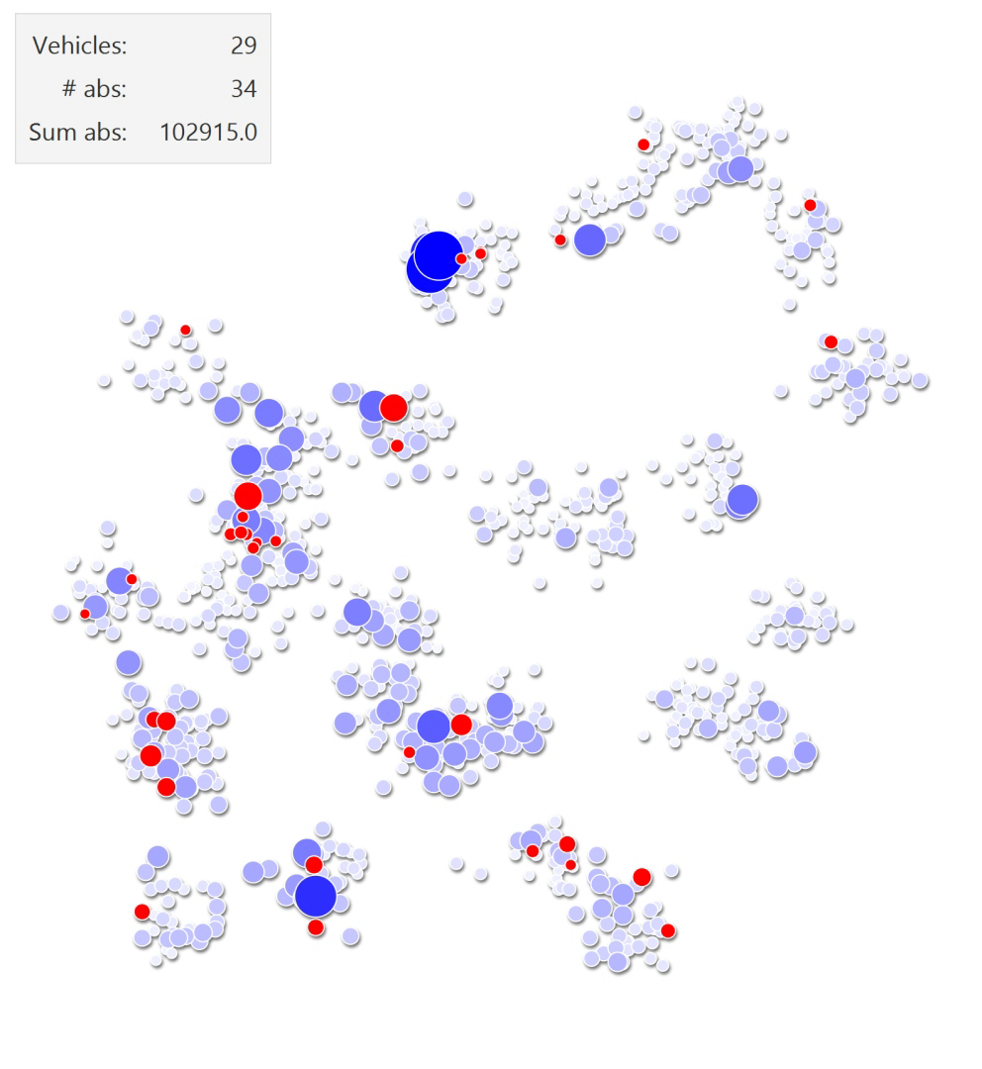
Notes:
Speelt tot moeilijke klanten verdwijnen

Slide 61
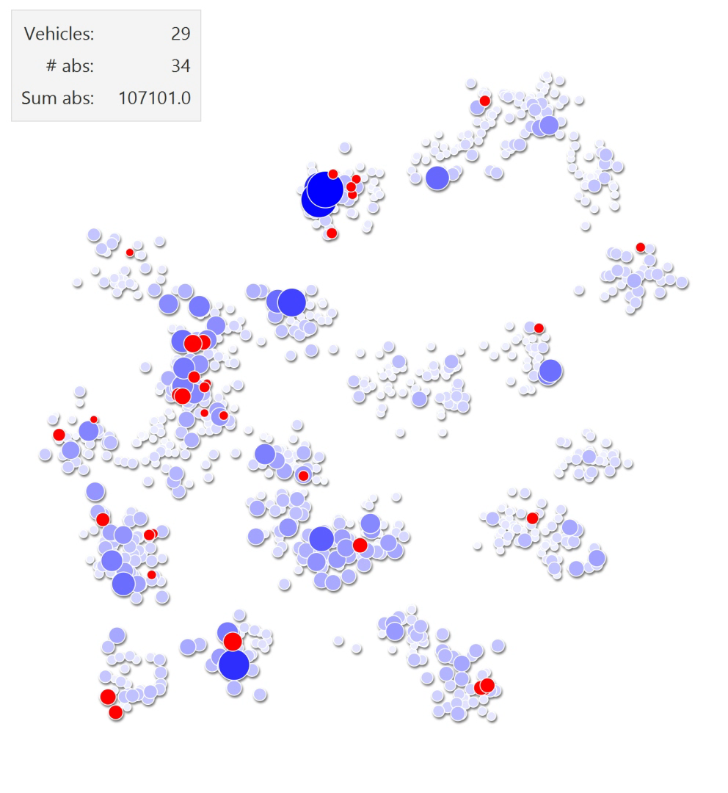
Notes:
Speelt tot moeilijke klanten verdwijnen

Slide 62
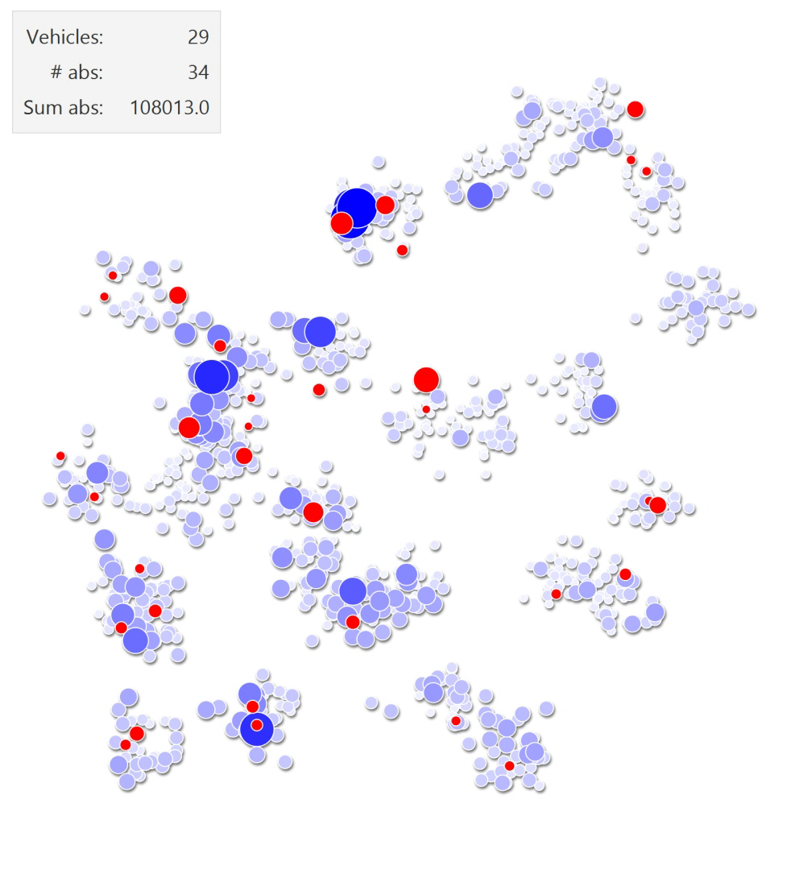
Notes:
Speelt tot moeilijke klanten verdwijnen

Slide 63
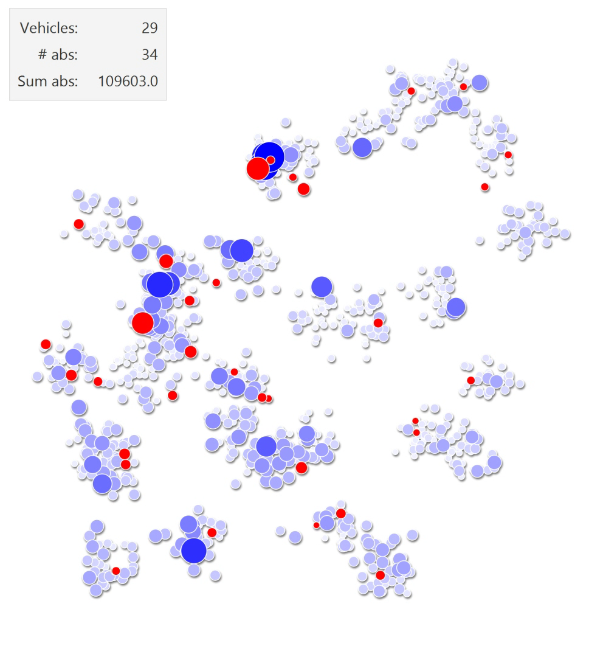
Notes:
Speelt tot moeilijke klanten verdwijnen

Slide 64
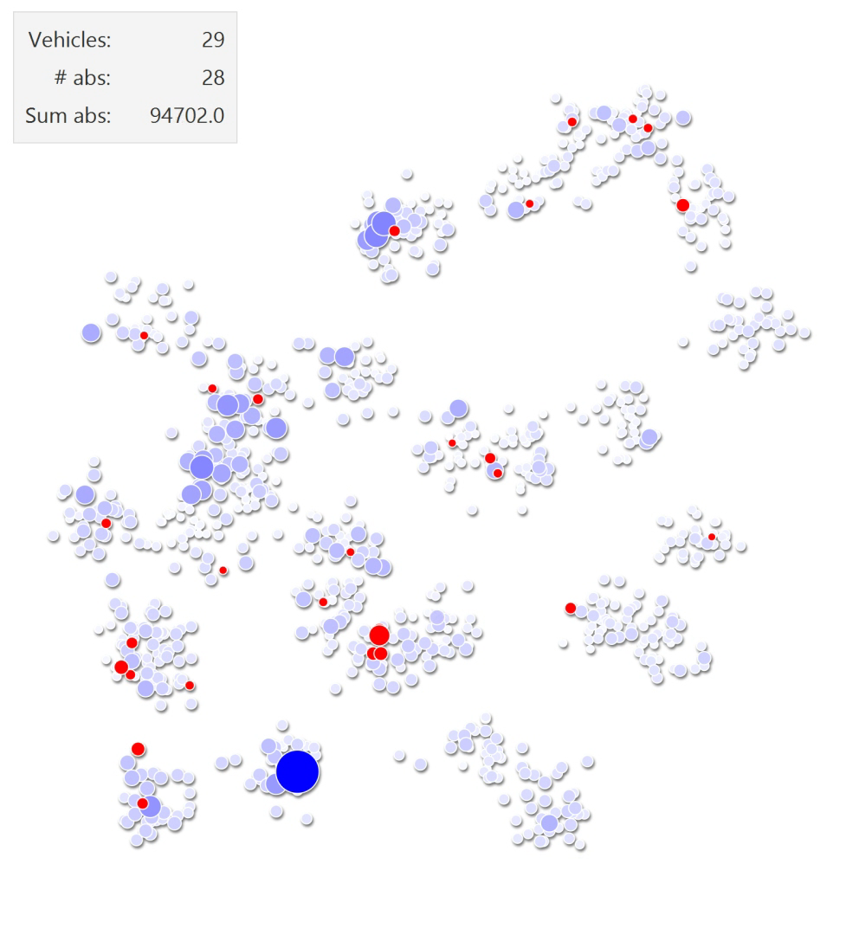
Notes:
Speelt tot moeilijke klanten verdwijnen

Slide 65
Acceptance criteria compared – Start

Slide 66
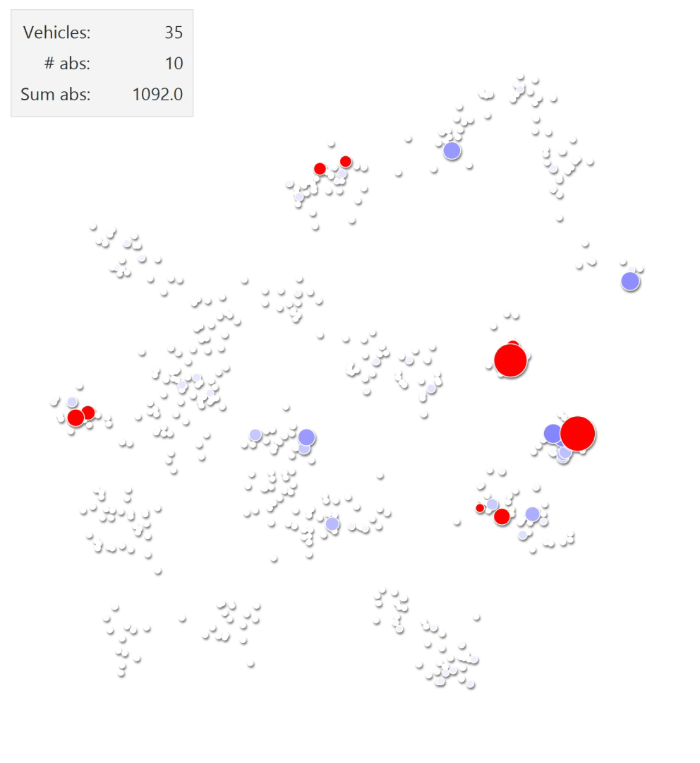
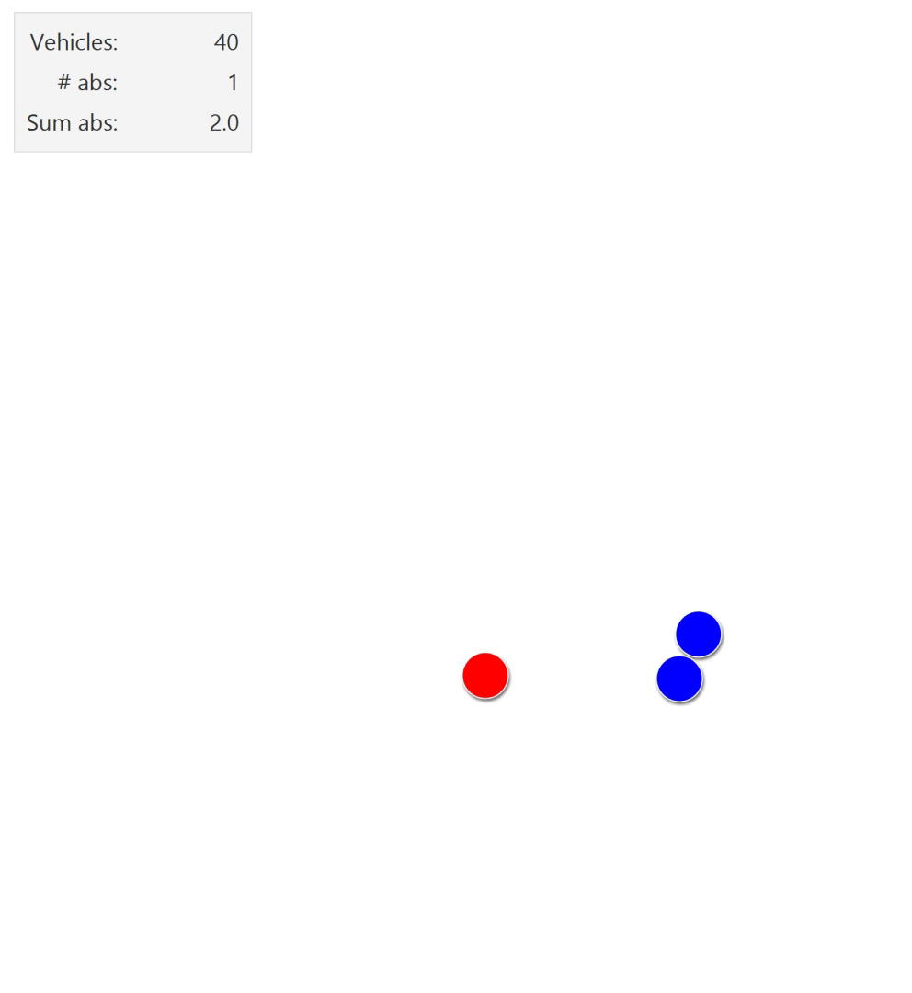
Acceptance criteria compared – Start
Notes:
Speelt tot moeilijke klanten verdwijnen

Slide 67
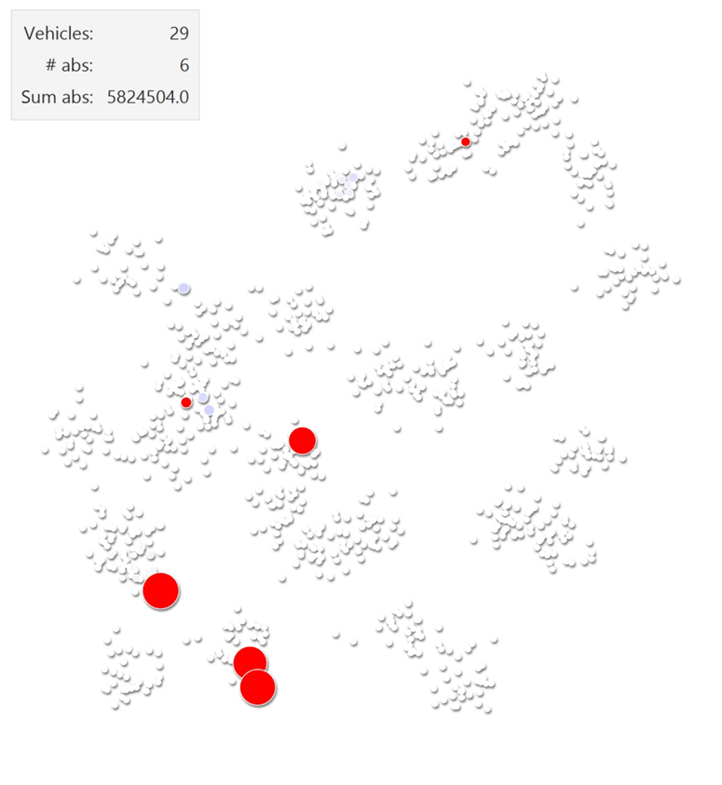
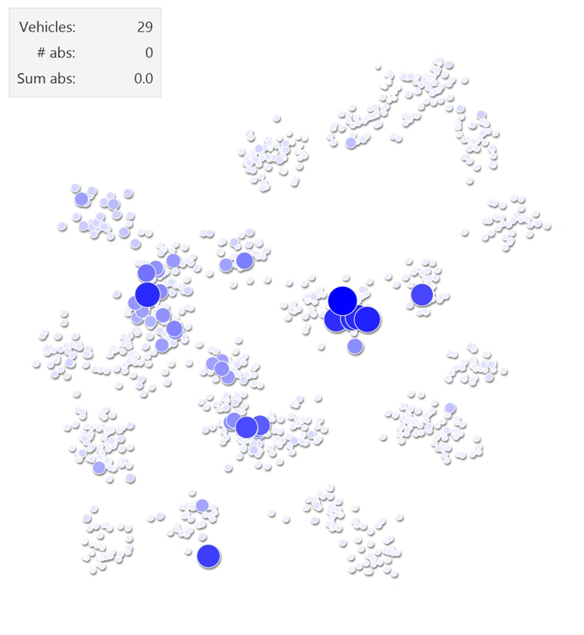
Acceptance criteria compared – Final solutions

Slide 68
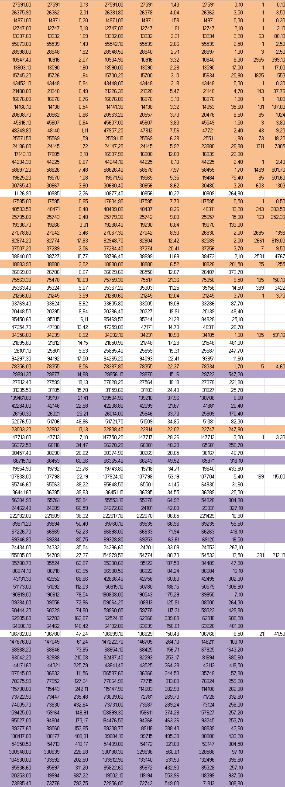
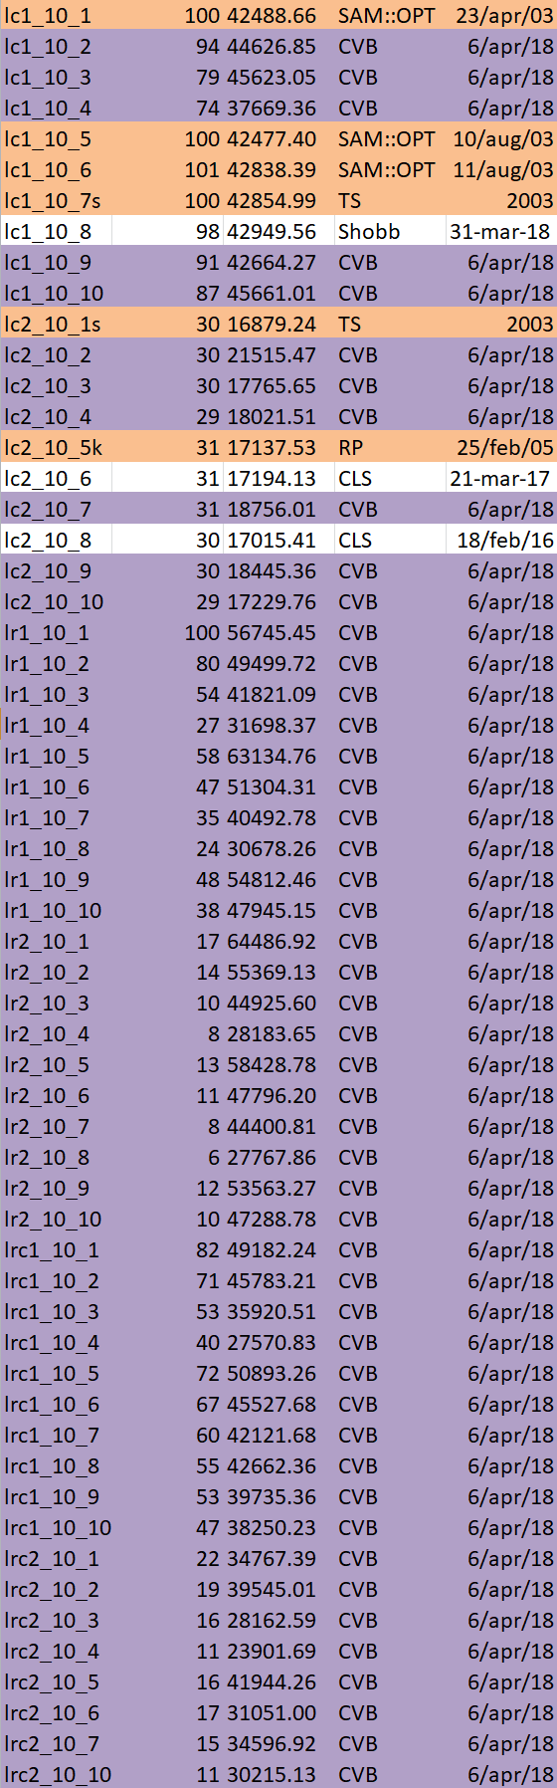
Some results
CVRP
Uchoa et al. (2017)
PDPTW
Li and Lim (2001)
100 instances
298 instances
40 equal
59 equal
40 improved
159 improved
(54 smaller fleet)
Notes:
Thibaut Vidal vernoemen, goed voor kleine problemen, veel probleemvarianten maar geen PDP

Slide 69
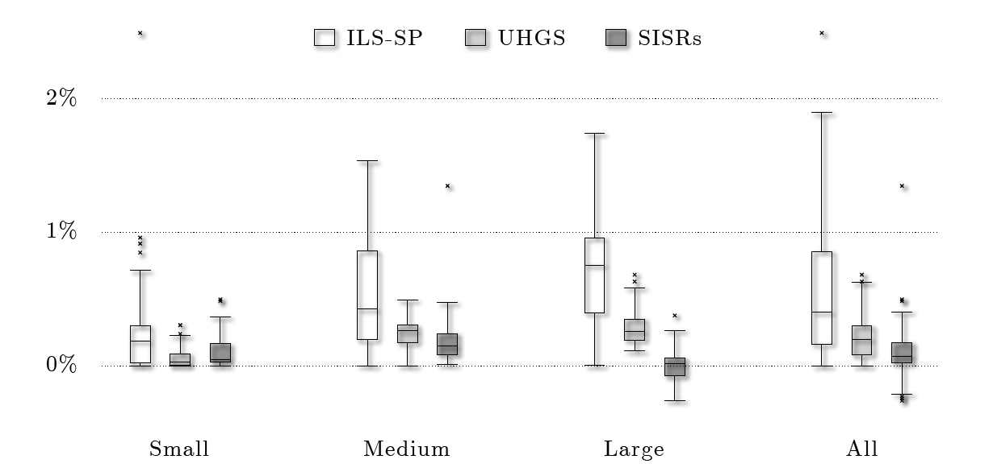

Slide 70
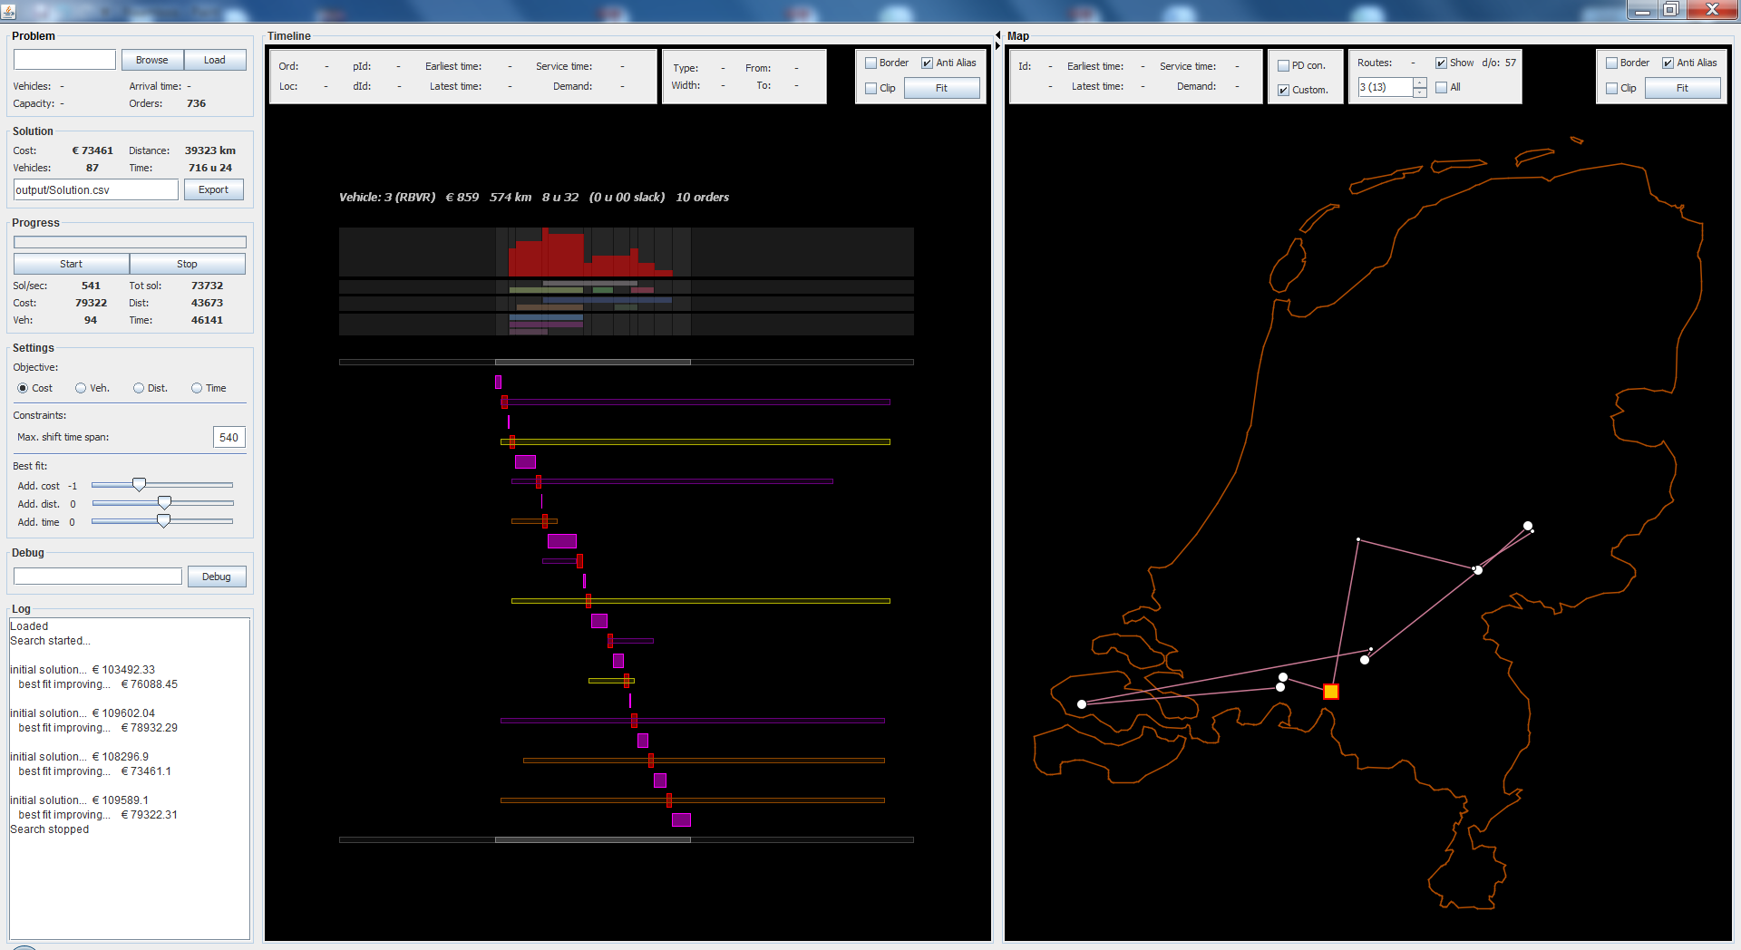

Slide 71
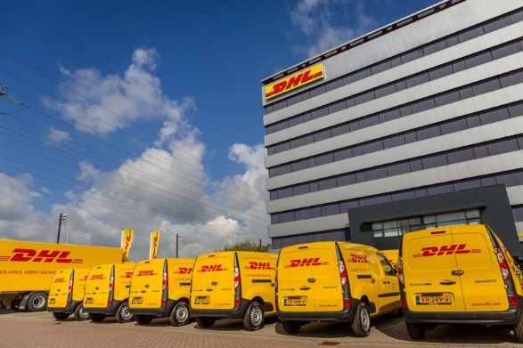
Notes:
DHL parcel or vletters

Slide 72
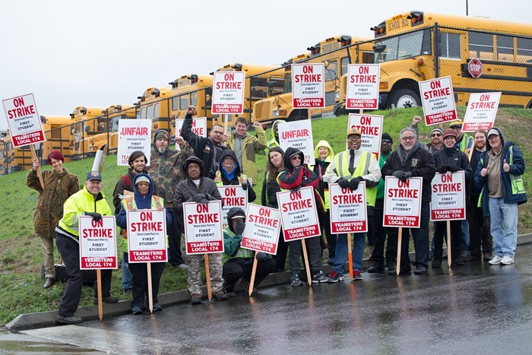

Slide 73
TR: Slack Induction by String Removals for Vehicle Routing Problems
Jan Christiaens, Greet Vanden Berghe 2018/5/7
https://lirias.kuleuven.be/handle/123456789/624431

